Slide 1
The State of Recovery
& American Life
Team 3 | Destiny’s Child
Koustav Bandyopadhyay | Alli Patnoe | Kelvin Walls

Slide 2
Overview
What’s the state of American life?
We set out to measure the state of recovery in America — despite ongoing, rising cases — from two perspectives:
Economic Affairs
Are Americans back at work?
Entertainment & Mobility
Are Americans eating out?
Are Americans traveling?
Then, we evaluated if these measures react to rising outbreaks, e.g., —
How well have businesses adapted?
What’s the state of COVID fatigue?
Notes:
Alli

Slide 3
Data Sources
CDC — new daily COVID-19 cases
Bureau of Labor Statistics — weekly new unemployment claims
OpenTable — percent change in Seated Diners vs. a year ago
TSA — daily passenger counts passing through U.S. airports
Notes:
Kelvin

Slide 4
Hypothesis
We expected our measures to respond to rising cases i.e., —
Unemployment claims would have a direct relationship with COVID-19 cases
Seated diners and travelers would have an inverse relationship with COVID-19 cases
Notes:
Koustav

Slide 5

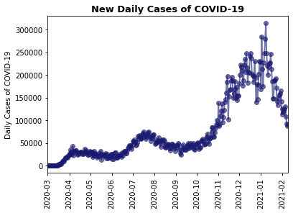
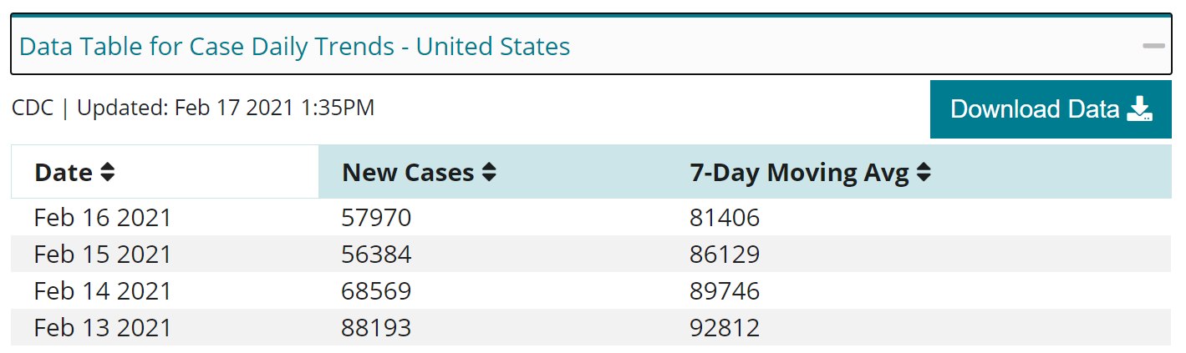
The Pattern of the Pandemic
New daily reported COVID-19 cases for the entire United States
Measured from March 2020 - December 2020
Notes:
Kelvin

Slide 6

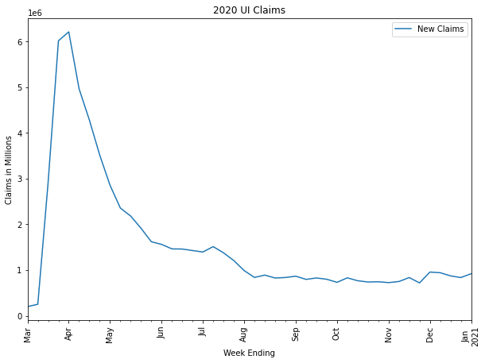
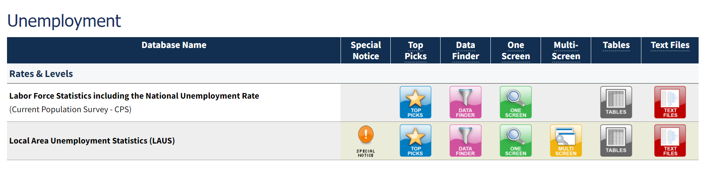
Are Americans back at work?
Weekly new unemployment claims
Repeat claimants are excluded from this data, so it is not a cumulative total or a measure of total unemployment

Slide 7
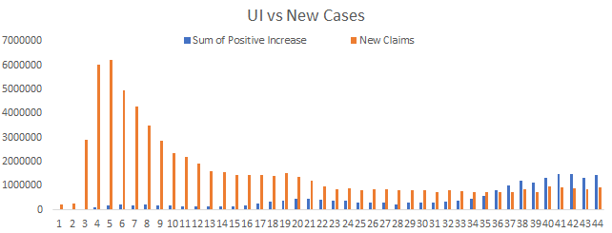
Do outbreaks create a rebirth of claims?
Correlation: -0.34
P-value: 0.000258
Statistics:
Negative Correlation between UI claims and new cases
Conclusions:

Slide 8
Many businesses have found a way to move forward, despite immense hurdles; however, we acknowledge that 10M+ Americans remain unemployed
Notes:
Koustav

Slide 9

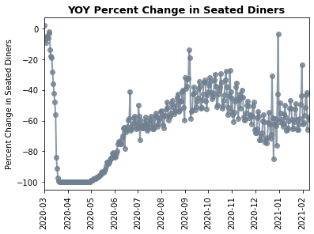
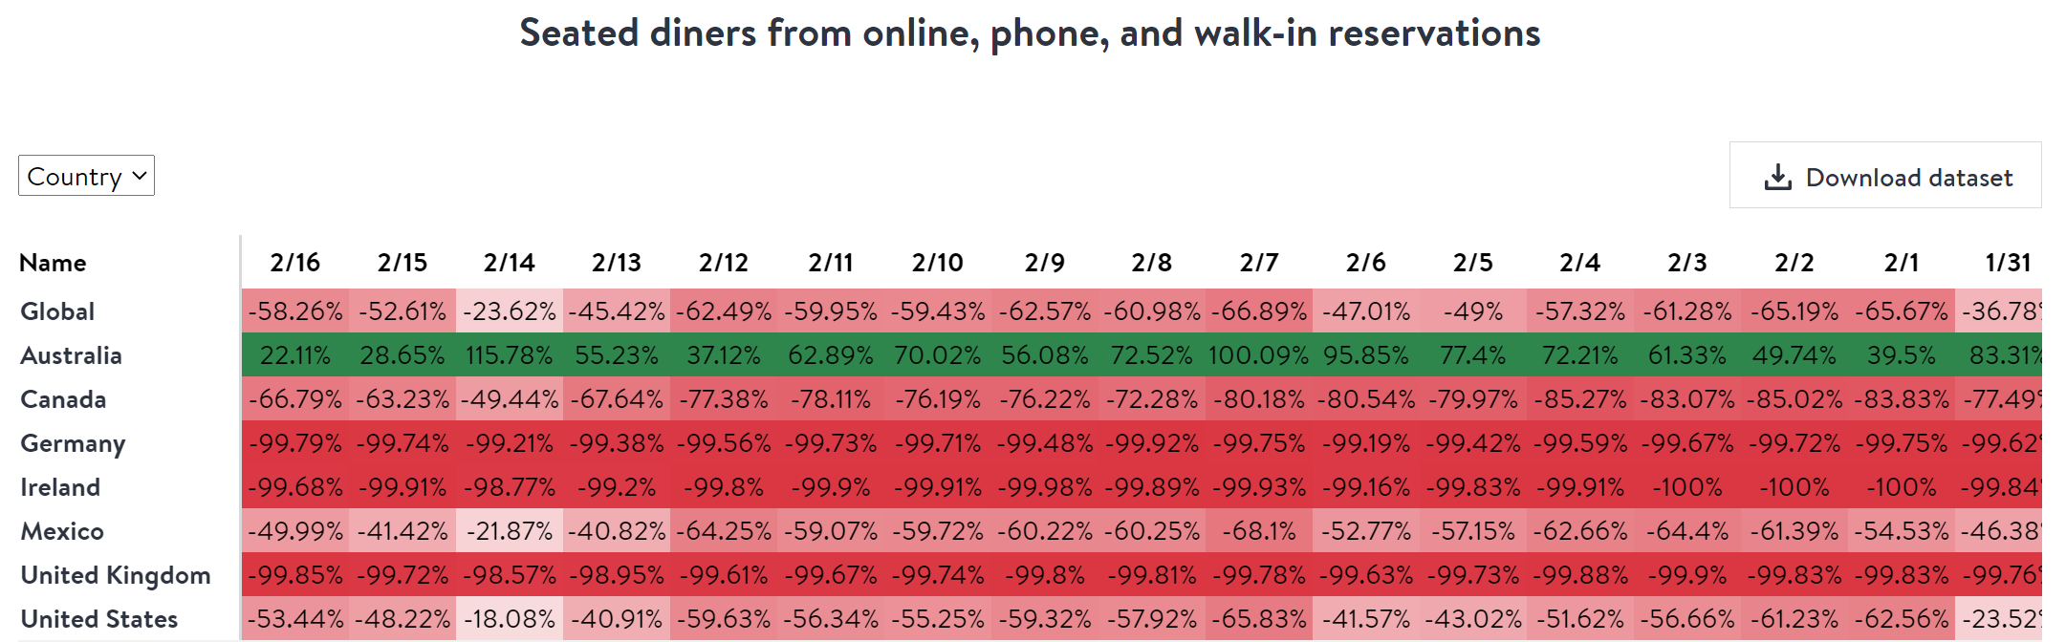
Are Americans eating out?
20,000 restaurants that provide OpenTable with information on all of their reservations
Data compared to the same day of the week from the same week in the previous year

Slide 10
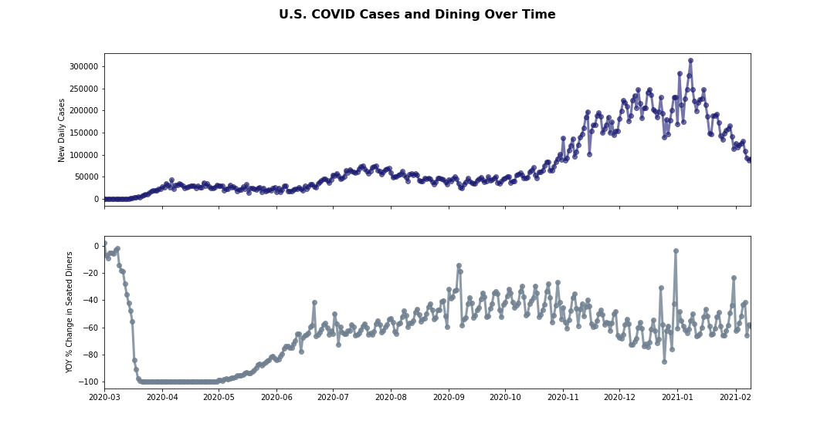
Are Americans changing their dining behavior in response to outbreaks?
Statistics:
Correlation: 0.176863
P-value: 0.000953
Concerns:
Long-time periods with variation in +/- correlation
Outliers over holidays based on comp over nature of data

Slide 11
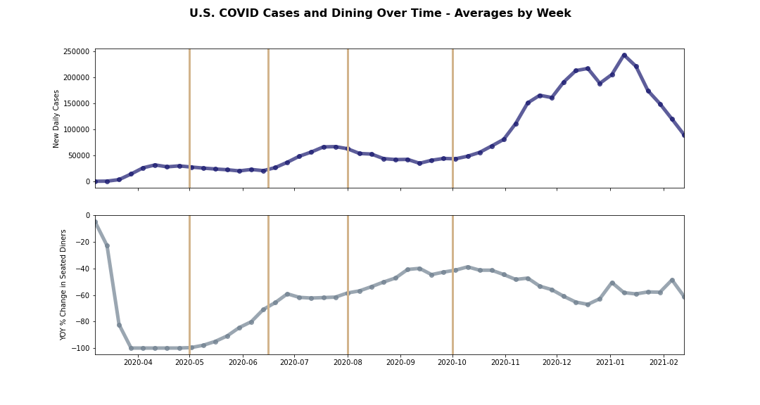
Are Americans changing their dining behavior in response to outbreaks?
Statistics:
In the Spring, Fall, and Winter, we see a significant negative correlation between new cases and dining out
In the Summer, we see a slightly positive correlation, but it is not significant
Spring
Summer
Fall
Winter
r
-0.801
0.316
-0.903
-0.962
p
0.030
0.541
0.001
1.4e-7
Conclusions:
At a national level, there was a visible response to outbreaks and recessions

Slide 12


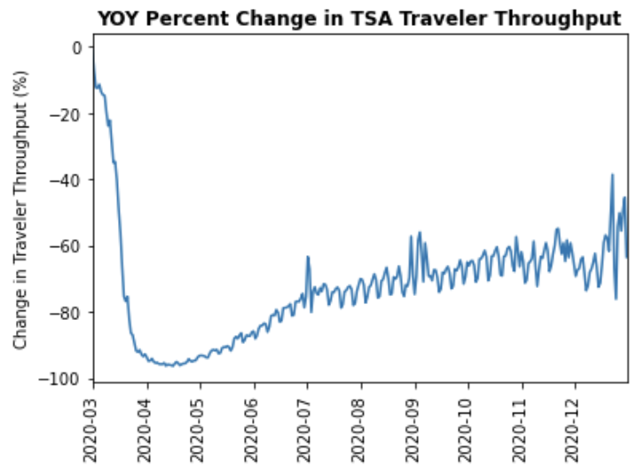
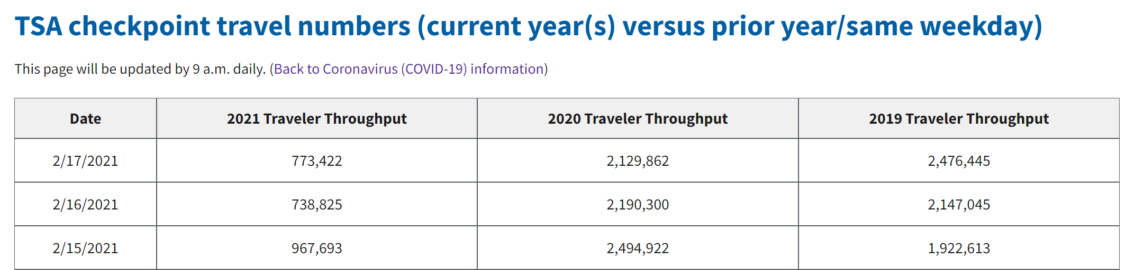
Are Americans traveling?
Number of passengers going through TSA checkpoints across the United States
Data compared to the same day of the week from the same week in the previous year

Slide 13
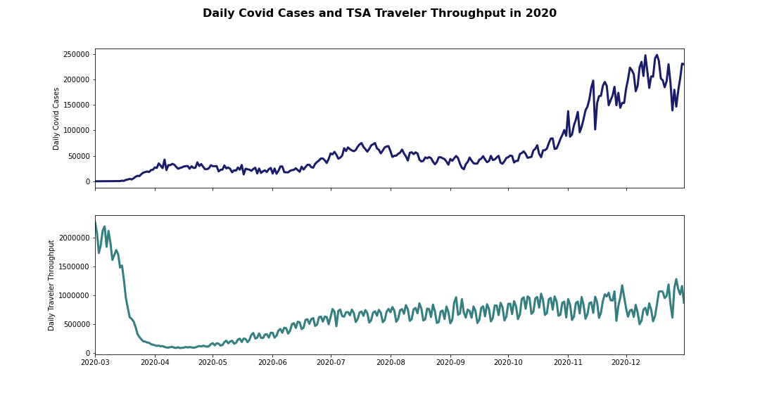
Are Americans postponing travel in response to outbreaks?
Correlation: 0.208712
P-value: 0.000236
Statistics:
Conclusions:
Cases and traveler throughput are positively correlated
Cases might not explain throughput as much as throughput explains cases

Slide 14
Americans have shown a willingness to re-enter public spaces, whether it be a restaurant or an airplane
Dips in seated diners may be more of a correlation vs. a causation; regulation and weather may have done more to change behavior than COVID-19

Slide 15
Thank you

Slide 16
References
Unemployment Claims: United States Bureau of Labor Statistics
Databases, Tables & Calculators by Subject (bls.gov)
COVID New Cases : Centers for Disease Control
CDC COVID Data Tracker
Dining : OpenTable
https://www.opentable.com/state-of-industry
Travel Data : TSA Passenger Checkpoints
TSA checkpoint travel numbers (current year(s) versus prior year/same weekday) | Transportation Security Administration

